Slide 1



CivicCore
CoDeX
Community
Transport Civic Issue Reporting & Resolution System

Slide 2
01
02
03
Fragmented Infrastructure & Complaint System
India faces severe road infrastructure deterioration and an unstructured complaint management system.
🚧 Potholes & Cracks: Rising accidents and vehicle damage (45,000+ annual accidents linked to poor roads)
🚦 Broken Signals: Malfunctioning traffic lights causing unsafe intersections
🛑 Missing Signage: Poor navigation and increased traffic confusion
🏢 No Centralized Platform: 15+ departments handle complaints separately, creating delays and inefficiency
Result: Delayed action, citizen frustration, and increased safety risks.
Citizen Impact & Urban Chaos
Delayed authority response and illegal parking are severely affecting daily life in urban areas.
⏳ Delayed Resolution (21 Days Avg.): Manual routing and unclear ownership cause weeks of inaction, increasing public frustration.
🚗 Illegal Parking (12,500+ Daily Violations): Unauthorized vehicles block roads, emergency lanes, and pedestrian pathways.
🚶 Footpath Encroachment: Citizens, especially elderly and children, are forced to walk on roads increasing accident risk.
🚨 Emergency Delays: Traffic bottlenecks slow down ambulances, fire services, and public transport.
Impact: Loss of time, safety risks, mental stress, and declining trust in public authorities.
Systemic Failure in Urban Governance
Urban mobility and complaint management systems are fundamentally broken, creating inefficiency at every level.
🚦 Traffic Congestion (45 min avg. delay): Peak hour jams, unmanaged bottlenecks, and poorly handled construction zones waste productive time daily.
🗂 Broken Complaint System (30+ Days Resolution): No real-time tracking, manual processing, and lack of accountability slow down action.
👁 Zero Transparency (0% Visibility): Citizens cannot track complaint status or assigned departments.
📊 Data Not Utilized (100% Wasted Potential): No analytics to detect hotspots, predict issues, or optimize resource allocation.
Core Issue: Disconnected systems + no data intelligence = reactive governance instead of proactive planning.

Slide 3
Key Features
One-Tap Registration
Citizens can report issues instantly with a single tap. Pre-filled location data and quick-capture camera streamline the process to under 30 seconds.
Auto Department Routing
AI-powered classification automatically forwards complaints to the correct department roads, traffic police, or municipal corporation eliminating manual sorting.
Priority Classification
Issues automatically classified as High, Medium, or Low priority based on severity, location impact, and safety risk. Critical problems get immediate attention.
Public Issue Map
Interactive map displays all reported issues in the city. Citizens can view nearby problems, track resolution progress, and avoid problematic routes.

Slide 4
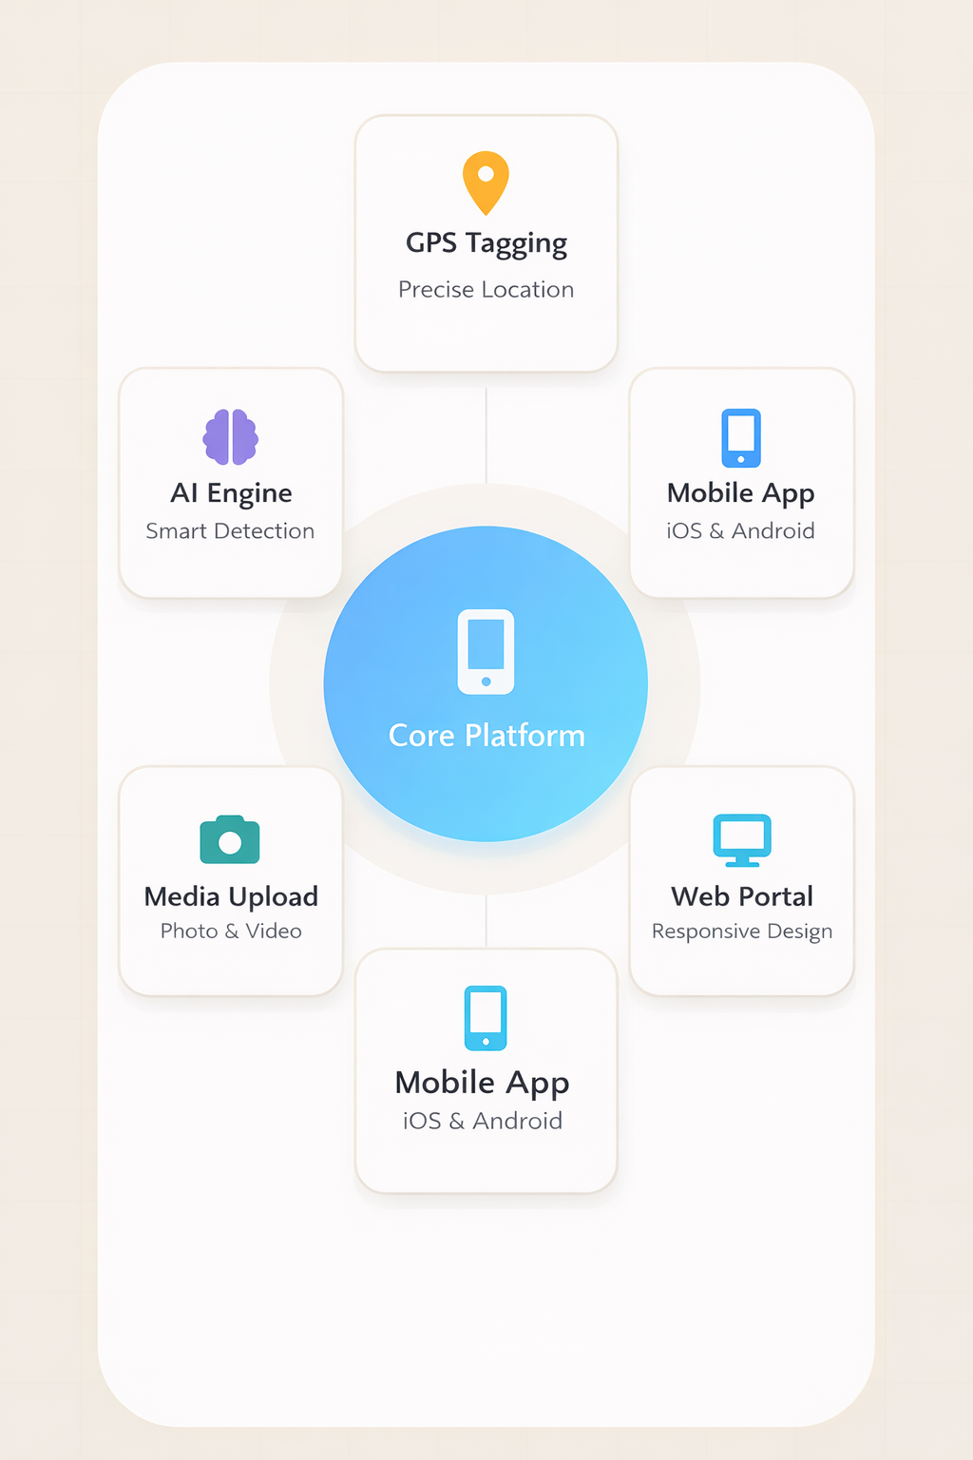
Real-Time Dashboard
01
Live tracking of all complaints with status updates, department assignments, and resolution timelines.
AI Verification
Computer vision validates issue authenticity, reducing false reports and prioritizing genuine problems.
02
Auto-Routing &Smart Notifications
AI-powered department assignment based on issue type, location, and workload, with real-time push alerts keeping citizens informed from submission to resolution.
03
Prototype Link - : Link

Slide 5



Target User
Municipal Departments
Receive AI-classified, prioritized complaints with smart workload distribution. Track performance & reduce resolution time efficiently.
City Administrators
Access analytics dashboards, hotspot mapping & predictive insights. Enable data-driven governance & proactive planning.
Citizens
Report civic issues instantly with photo, GPS & real-time tracking. Stay informed with push notifications until resolution.

Slide 6


Competitive Analysis
Traditional Complaint Systems
• No centralized platform (15+ departments scattered)
• 21+ days average response time
• No real-time tracking or transparency
Helpline / Offline Reporting
• Manual routing & paperwork delays
• No data analytics or hotspot detection
• Limited accountability
Basic Civic Apps
• Complaint logging only (no AI classification)
• No predictive analytics
• Weak cross-department coordination
CivicCore (Our Advantage)
• AI-powered auto classification & smart routing
• Real-time tracking & push notifications
• Data-driven insights & predictive governance

Slide 7

Future Roadmap
Transforming civic reporting into a predictive, AI-powered smart city ecosystem
Prototype
Feb 2026
Launch
Dec 2026
Validate
May 2027
Improve
Dec 2027

Slide 8


Thank You!
CoDeX
#01 Leader
Shubham Shukla
#02 Aakash rana
#03 Farman Khan
#04 TaraShankar Hazra
#05 Vansh verma
Phone Number
Your Phone Number
8076635012
9868369666
6389399289
9811996671
9310584042
E-Mail Address
Your E-Mail Address
shubhushukla586@gmail.com
aakashrana7422@gmail.com
farmanfk0404@gmail.com
tarashankarhazra30@gmail.com
Vanshverma20406@gmail.com
University
College Name, Year, and Course
DITM , 2nd year, Btech Cse
DITM , 2nd year, Btech Cse
DITM , 2nd year, Btech Cse
DITM , 2nd year, Btech Cse
DITM , 2nd year, Btech Cse

